Slide 2
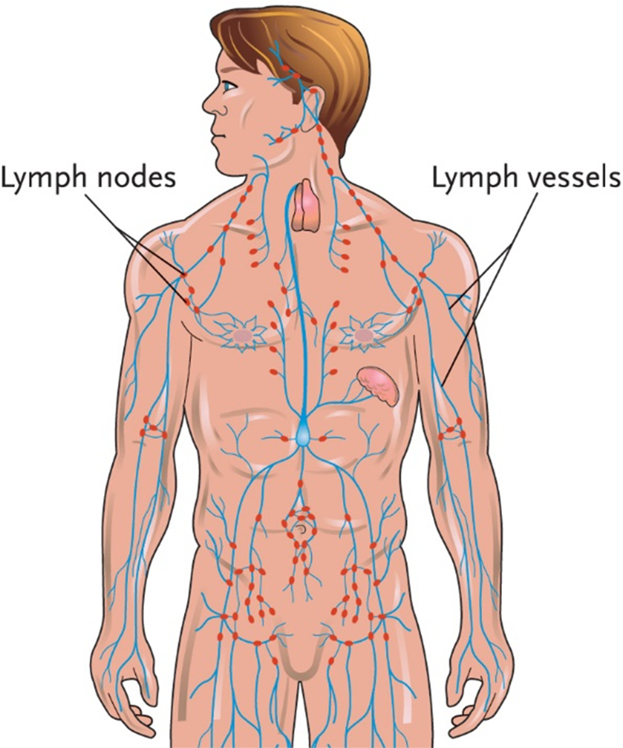
Chapter 19, LO1, content 1
Key Material19-1: The Lymphatic System

Slide 3
LO1, content 2
Describe the structure and function of the immune and lymphatic systems
Remember the following points about the lymphatic system:
Functions of the system are to remove excess fluids and waste products and to help the immune system fight infection
It is closely related to the circulatory system because lymph fluid, after being purified in the lymph nodes, flows into the bloodstream
It has no pump, but is circulated by muscle activity, massage, and breathing

Slide 4
LO1, content 3
Describe the structure and function of the immune and lymphatic systems
Normal changes of aging include the following:
Weakened immune system increases risk of infections
Takes longer to recover from an illness
Decreased number and size of lymph nodes
Decreased response to vaccines

Slide 5
LO2, key terms 1
Discuss common medications used to treat HIV/AIDS
Define the following terms:
acquired immunodeficiency syndrome (AIDS)
the final stage of HIV infection, in which infections, tumors, and central nervous system symptoms appear due to a weakened immune system that is unable to fight infection.
human immunodeficiency virus (HIV)
the virus that attacks the body’s immune system and gradually disables it; eventually can cause AIDS.
opportunistic infection
an infection that invades the body when the immune system is weak and unable to defend itself.

Slide 6
LO2, content 1
Discuss common medications used to treat HIV/AIDS
Understand the following about treatment for HIV/AIDS:
Antiretroviral therapy involves three or more medications that slow/control the HIV virus
Some ART medications reduce chemicals in the body that HIV needs to make copies of itself
Some prevent HIV from combining with the patient’s DNA
Drug classes involved in ART include the word [ITAL]inhibitor[/ITAL] because they slow down particular body processes.
ART medications have many unpleasant side effects, including nausea, vomiting, diarrhea, fever, and skin rashes
Treatment also involves relieving symptoms and prevention/treatment of opportunistic infections
Table on textbook p. 178 (or handout) details specific drugs

Slide 7
LO2, content 2
Discuss common medications used to treat HIV/AIDS
Care guidelines for HIV/AIDS include the following:
Follow Standard Precautions. Follow Transmission-Based Precautions as ordered
Wash hands often and keep things clean to protect residents with compromised immune systems
Some people with HIV/AIDS lose their appetites and have difficulty eating. Follow any ordered dietary guidelines
Many antiretroviral drugs can cause liver problems. Observe and report signs such as jaundice to the nurse
Some medications can cause serious adverse effects. Observe and report carefully
Report to a supervisor immediately if exposed to blood/body fluids

Slide 8
LO3, key terms 1
Describe common treatments for cancer
Define the following terms:
cancer
general term to describe a disease in which abnormal cells grow in an uncontrolled way.
tumor
a cluster of abnormally growing cells.
benign tumor
a tumor that is considered noncancerous.

Slide 9
LO3, key terms 2
Describe common treatments for cancer
Define the following terms:
malignant tumor
a tumor that is cancerous.
lymphoma
a form of cancer affecting white blood cells and lymphatic tissue, including the lymph nodes, thymus gland, spleen, and bone marrow.
leukemia
a form of cancer affecting the blood and bone marrow.

Slide 10
LO3, content 1
Describe common treatments for cancer
Understand the following about treatments for cancer:
Surgery is front line of defense for most forms of cancer
Chemotherapy refers to medications given, usually intravenously, to fight cancer
Can have severe side effects, including nausea, vomiting, diarrhea, oral sores, hair loss, fatigue, and decreased resistance to infection
Medications may be administered to treat symptoms caused by side effects
Radiation therapy (radiotherapy) directs radiation to a limited area to kill cancer cells
Immunotherapy uses a person’s own immune system to fight disease
MAs do not administer chemotherapy drugs (most are IV), but may administer medications to ease side effects
Table on textbook p. 178 (or handout) details specific drugs

Slide 11
LO3, content 2
Describe common treatments for cancer
Care guidelines for cancer include the following:
Each case is different. Cancer is a general term and refers to many individual situations. Do not make assumptions about a resident’s condition
Cancer can cause great pain, especially in the late stages. Be alert for signs of pain and report them to the nurse
Follow facility procedures for administering mediations. Cancer treatments can put residents at a higher risk of infection. Additional infection prevention practices may be in place
Do not apply lotion or any topical medication to areas receiving radiation therapy unless ordered to do so. Do not remove markings used in radiation therapy
Report any signs of infection, such as fever, malaise, and fatigue

Slide 12
LO4, key terms 1
Discuss common medications used to treat rheumatoid arthritis, lupus, and shingles
Define the following terms:
rheumatoid arthritis
a type of arthritis in which joints become red, swollen, and very pain­ful, resulting in restricted movement and pos­sible deformities.
lupus
a chronic autoimmune disease in which the body attacks its own healthy tissues.
shingles
a skin rash caused by the varicella-zoster virus (VZV) that causes pain, tingling, itching, and a rash of fluid-filled blisters.

Slide 13
LO4, content 1
Discuss common medications used to treat rheumatoid arthritis, lupus, and shingles
Understand the following about treatment for rheumatoid arthritis:
Disease-modifying antirheumatic drugs (DMARDs) work with the immune system to slow progression of RA
Biologic DMARDs may be used if DMARDs are not effective (administered by injection)
NSAIDs may be ordered for pain control
Oral or injected corticosteroids reduce inflammation and can relieve RA symptoms
Table on textbook p. 179 (or handout) details specific drugs

Slide 14
LO4, content 2
Discuss common medications used to treat rheumatoid arthritis, lupus, and shingles
Understand the following about treatment for lupus:
Antimalarial agents change the immune system in a way that can relieve lupus symptoms
Corticosteroids reduce inflammation
Immunosuppressant drugs can slow the damaging immune response caused by lupus
Residents with lupus may be more prone to infection because of these medications
Table on textbook p. 180 (or handout) details specific drugs

Slide 15
LO4, content 3
Discuss common medications used to treat rheumatoid arthritis, lupus, and shingles
Understand the following about treatment for shingles/post-herpetic neuralgia:
Vaccine can help reduce risk of contracting shingles
Antiviral agents can reduce severity/shorten length of illness
Analgesics (NSAIDs, acetaminophen) help manage pain; severe pain may be treated with opioids
Tricyclic antidepressants, anticonvulsants, and topical anesthetics are possible treatments for post-herpetic neuralgia
Table on textbook pp. 180–181 (or handout) details specific drugs

Slide 16
LO4, content 4
Discuss common medications used to treat rheumatoid arthritis, lupus, and shingles
Care guidelines for RA, lupus, and shingles include the following:
Observe for gastrointestinal bleeding in residents taking NSAIDs. Report any concerns to the nurse
Report any signs of infection (fever, malaise, fatigue) in residents taking immunosuppressant drugs
Observe residents taking opioid analgesics for signs and symptoms of over-sedation (slow breathing, low oxygen levels, hard to wake)
Observe and report signs of uncontrolled pain

